Slide 1

Societal Project On WOMEN’S SAFETY APP

Slide 2
Introduction
Here We introduce an app which ensures the safety of women. This helps to identify and call on resources to help the one out of dangerous situations. These reduce risk and bring assistance when we need it and help us to identify the location of the one in danger. This app provides the awareness on the time crucial situation for women.
Aim of the Project :
The aim of the Women’s safety app project is to enhance user safety by a providing a platform to share real time location with trusted locators . Additionally the app aims to empower women to marigate their surroundings confidently .

Slide 3
Literature Survey :
Paper Name : SURVEY ON WOMEN SAFETY DEVICES
Authors : Ramya K1, Vimal T2 .2020
Description : Today in the current global scenario, women feel less secure to go outside. They are facing so many consequences in this in- dependent world. Here, we are focusing on as scenario where the women walking alone on the road faces harassment either from the front or back- side during day or nighttime. To overcome these issues, we have developed a smart portable device which can track the current location of the victim. When they will feel insecure, their heartbeat increases which can be measured by the pulse sensor and their stress level is monitored.

Slide 4
Abhaya: An android app for the safety of women
Description :This paper presents Abhaya, an Android Application for the Safety of Women and this app can be activated this app by a single click, when ever need arises. A single click on this app identifies the location of place through GPS and sends a message comprising this location URL to the registered contacts and also call on the first registered contact to help the one in dangerous situations. The unique feature of this application is to send the message to the registered contacts continuously for every five minutes until buttons in the application is clicked. Continuous location tracking information via SMS helps to find the location of the victim quickly and can be rescued safely.
Pros and Cons of this app
This app continuously send message for every 5 mins until the user click the stop button. The message contains the location URL and it also call on the first registered contact.
The working of this app is quite lengthy, though it provides continuous location of the user but the continuous access to the
Internet is required. Any trouble in network will lead to big problem since the only way to give the information to our registered number is through Internet and if at all the Internet accessibility is not possible then it will not help in any way

Slide 5
Problem statement :
In previous app there is no such function provide for safety tips and tricks. In this app there is s feature to find nearby hospitals, police stations in emergency situation.
Existing System :
There are certain Women security Applications which are quite similar to our application. To date it is identified that the following Android Apps of women security are good and are offering relatively similar service. For Example-
bSafe:
This app allows women to alert their friends and family in case of an emergency with just a tap on the app. The app also includes a GPS tracker, timer alarm, fake call feature, and voice activation.
Drawbacks of existing system:
Limited Regular Usage.
Reduced User Familiarity.
Difficult to inform immediately the location of the user in trouble.

Slide 6
Proposed System:
The proposed system is for women safety and overcomes the disadvantages of the existing system. This proposed system is GPS Based “Women Security System”. It consists of GPS device i.e. any Android Phone. The device will provide the position information of the user when user shake his\her Handset,after that a SOS will be generated and send SMS to the emergency contacts.
Advantages of Proposed System:
Enhanced Personal Safety
User-Friendly Interface
Encourages Reporting and Action

Slide 7
Technology used :
Android Studio
Android Studio was first announced at a Google I/O conference in 2013 and was released to the general public in 2014 after various beta versions. The current stable version is 3.0 released in October 2017.
As an IDE, Android Studio’s job is to provide the interface for developers to create their apps and to handle much of the complicated file-management behind the scenes. Android Studio is simply where developers will write, edit and save their projects
and the files that comprise said projects. At the same time, Android Studio gives access to the Android SDK or ‘Software Development Kit’. Android Studio also enables to run the code, either through an emulator or through a piece of hardware connected to the machine.

Slide 8
Overview of Flutter
Flutter is an open source framework developed and supported by Google. Frontend and full-stack developers use Flutter to build an application’s user interface (UI) for multiple platforms with a single codebase.
Flutter uses the open-source programming language Dart, which was also developed by Google. Dart is optimized for building UIs, and many of Dart’s strengths are used in Flutter. When Flutter launched in 2018, it mainly supported mobile app development. Flutter now supports application development on six platforms: iOS, Android, the web, Windows, MacOS, and Linux. Coding an application
for one specific platform, such as iOS, is called native app development. By contrast, cross-platform app development is building an
application for multiple platforms with a single codebase.
The advantages of Flutter
Close-to-native performance
Fast, consistent, and customizable rendering
Developer-friendly tools

Slide 9
Introduction to Dart Programming
Dart is a client-optimized language for developing fast apps on any platform. Its goal is to offer the most productive programming language for multi-platform development, paired with a flexible execution runtime platform for app frameworks. Dart is designed for a technical envelope that is particularly suited to client development, prioritizing both development (sub-second stateful hot reload) and high-quality production experiences across a wide variety of compilation targets (web, mobile, and desktop).
Dart also forms the foundation of Flutter. Dart provides the language and runtimes that power Flutter apps, but Dart also supports many core developer tasks like formatting, analyzing, and testing code.

Slide 10
Firebase :Realtime Database
The Firebase Realtime Database is a cloud-hosted database in which data is stored as JSON. The data is synchronized in real-time to every connected client. All of our clients share one Realtime Database instances and automatically receive updates with the newest data, when we build cross-platform applications with our iOS, and JavaScript SDKs. The Firebase Realtime Database is a NoSQL database from which we can store and sync the data between our users in real-time. Real-time syncing makes it easy for our users to access their data from any device, be it web or mobile.

Slide 11
Hardware requirements:
Software requirements:
Hard disk | 10GB
RAM | 8GB recommended
Device | IOS or Android mobile
OS | Windows 10,11
Languages Used | Dart programming
Development Environment (IDE) | Android Studio
Database | Firebase Realtime Database
Software’s | Android SDK

Slide 12
MODULES
Modules of the Project :
This system comprises of 3 major modules
Admin
Guardian
User

Slide 13




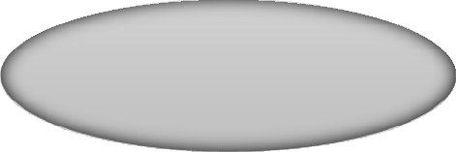

Admin:
This module contains the information about admin.
View Users
View Guardian
Add Modules
Delete Users\Guardian
Admin
Add videos
Request for permission

Slide 14


Guardian:
This module contains the information about Guardian . Once the Guardian logged into the app He/She can view users
and can view or track current location of the user.
View User location
Guardian

Slide 15






Users:
This module contains the details of user. Once user sign in with valid information He/She can add or delete Guardian .Users can search for nearby Police station, Hospitals, Bus stations and also they can share their current location.
Update Location
Manage Guardians
SMS Alert
Search nearby Services
View Modules & Videos

Slide 16
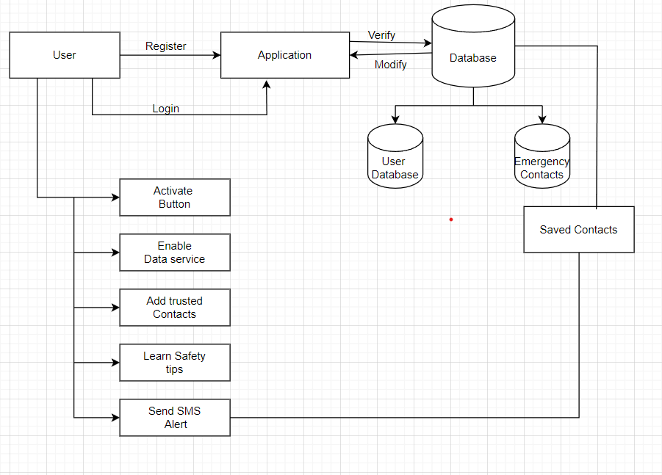
System Architecture :

Slide 17
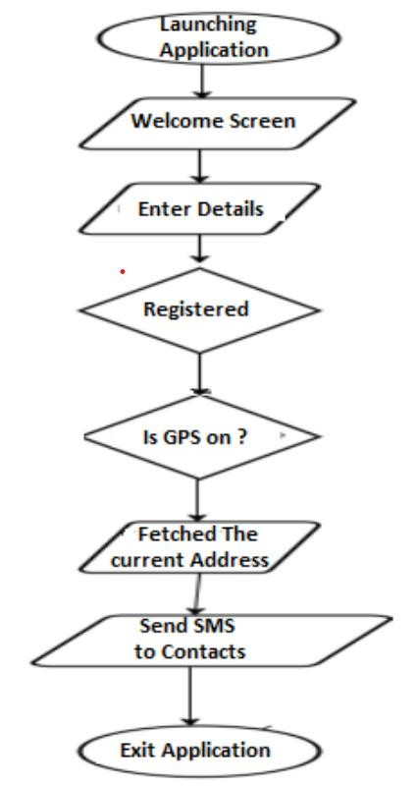
Data Flow Diagram:

Slide 18
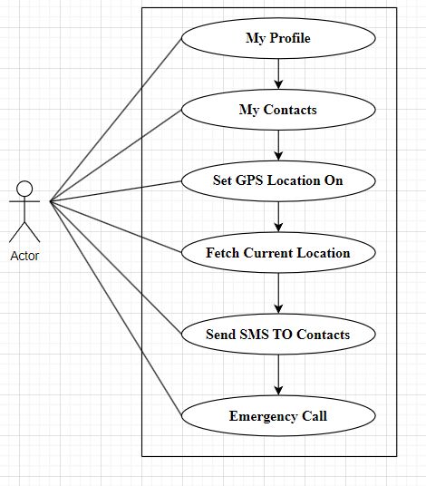
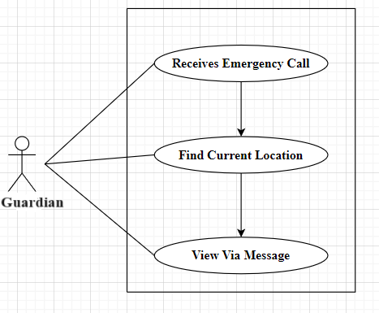
Use-Case Diagram :

Slide 19
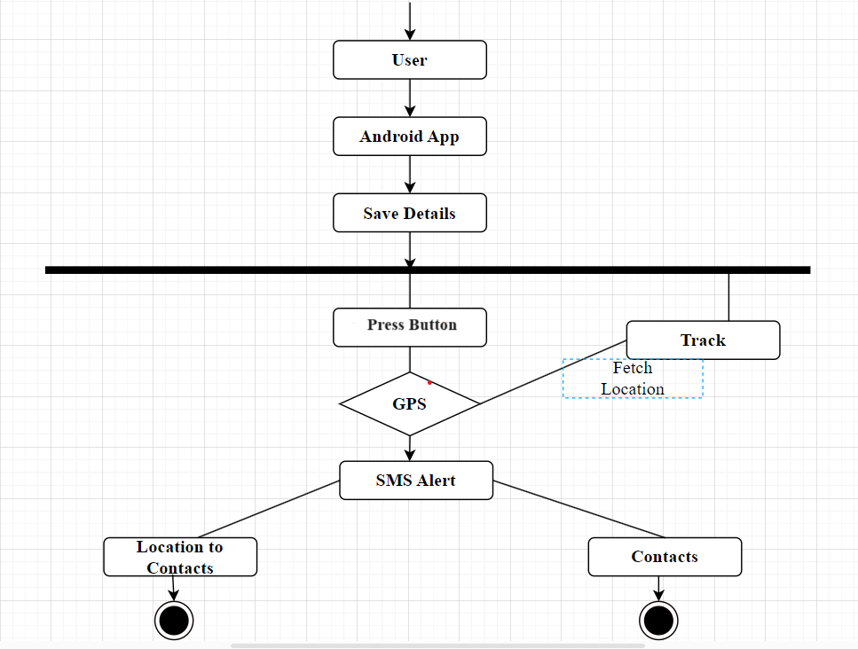
Activity Diagram :

Slide 20
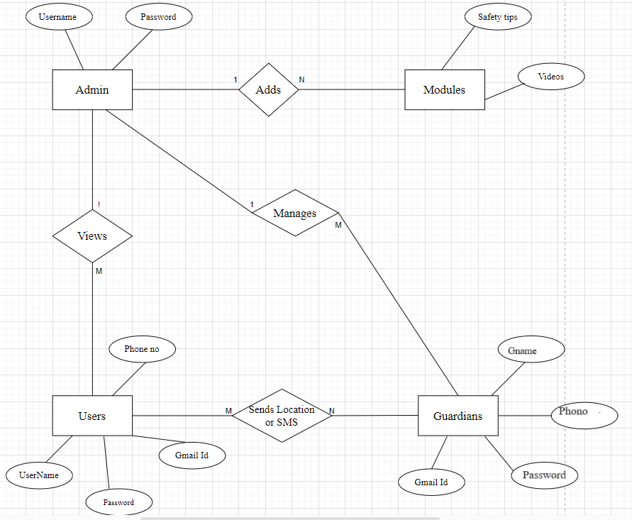
ER-Diagram :

Slide 21
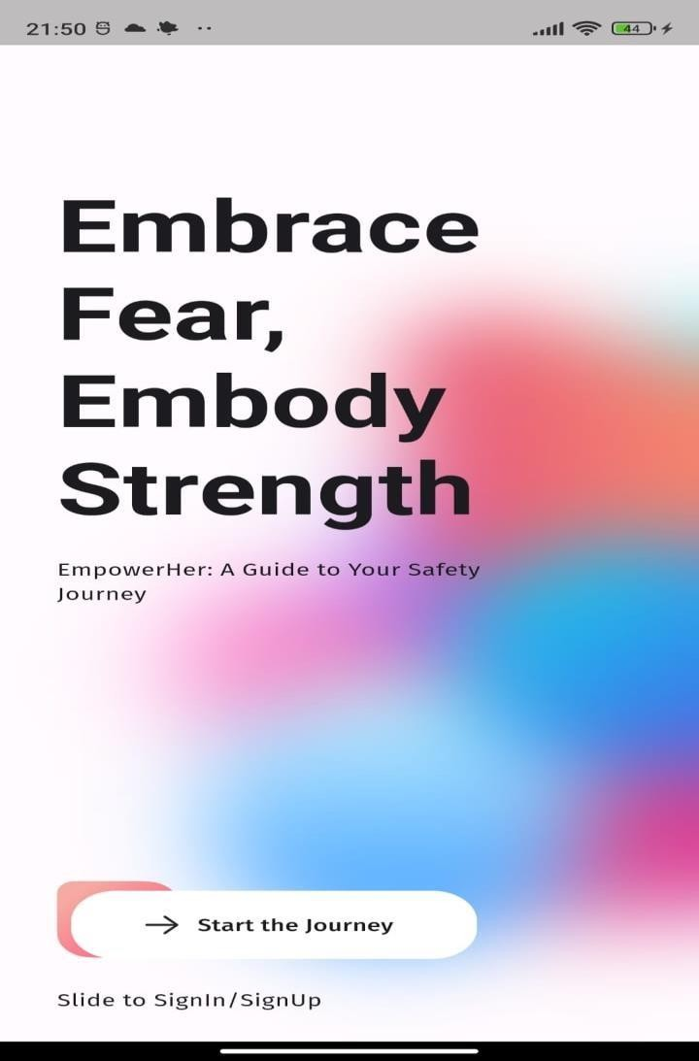
SCREENSHOTS :
1. On Boarding Screen
Embrace Fear:
Recognize and accept the existence of fear. Understand
that fear is a natural and universal emotion.
Embody Strength:
Cultivate inner strength and resilience. This involves
building mental toughness to face challenges head-on.
Welcome page

Slide 22
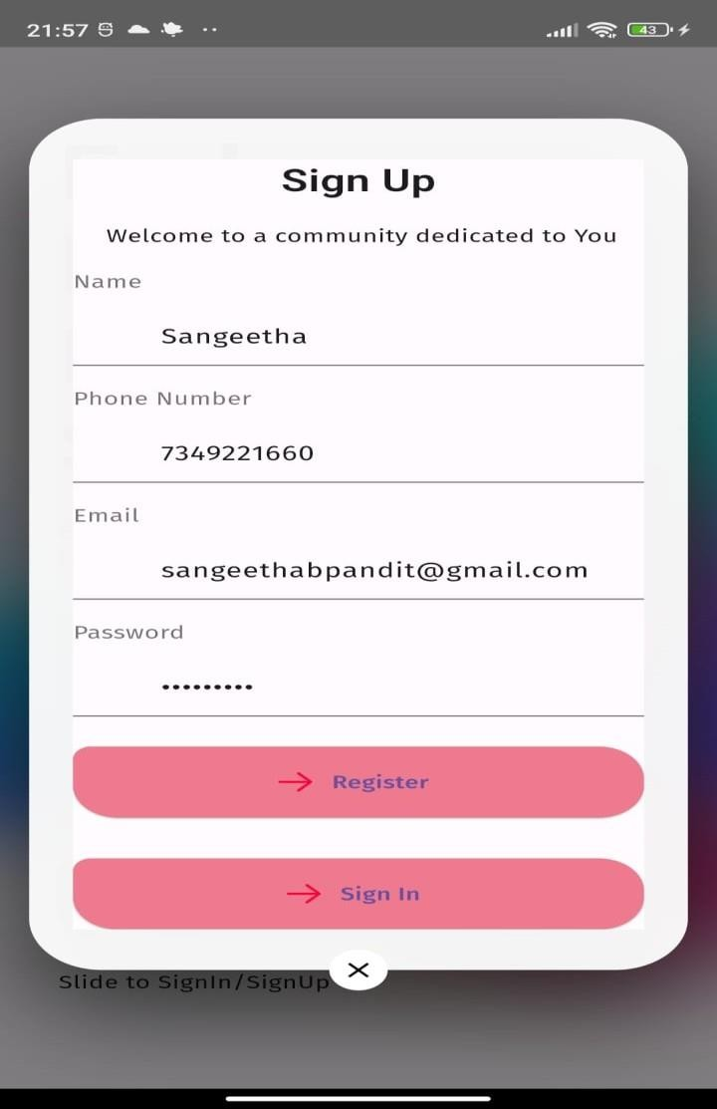
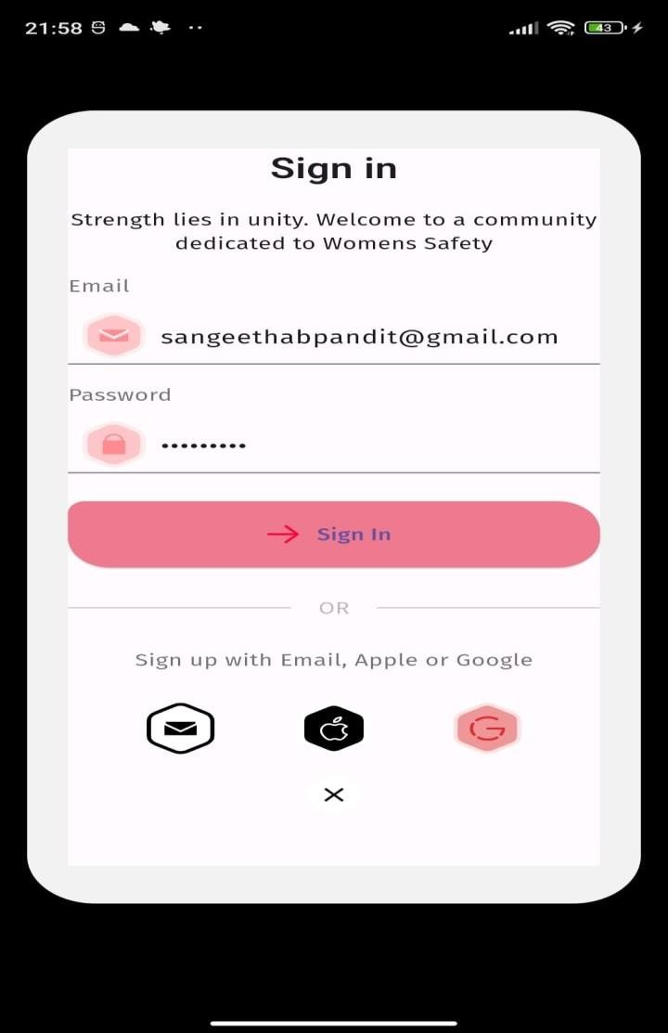
SIGN UP & SIGN IN SCREEN

Slide 23
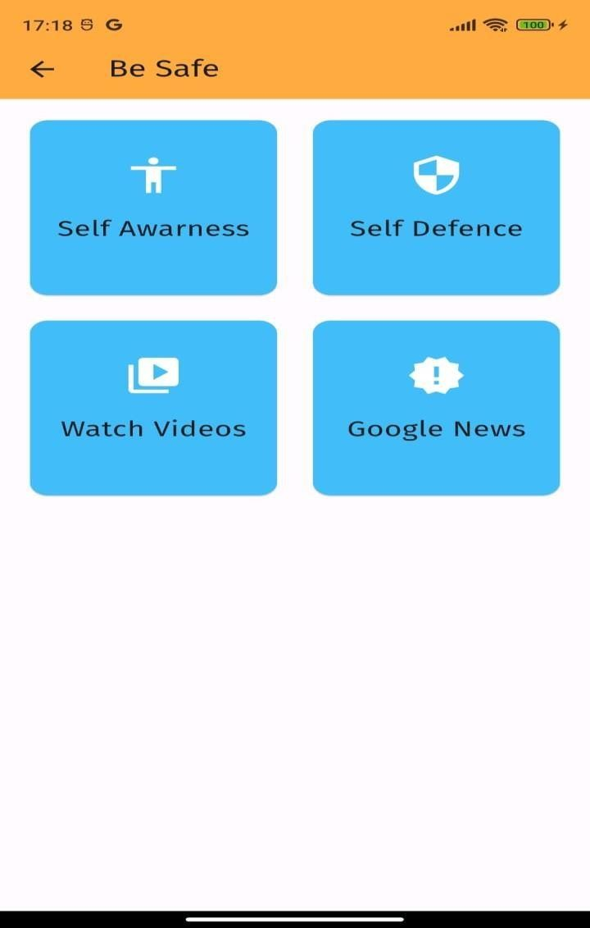
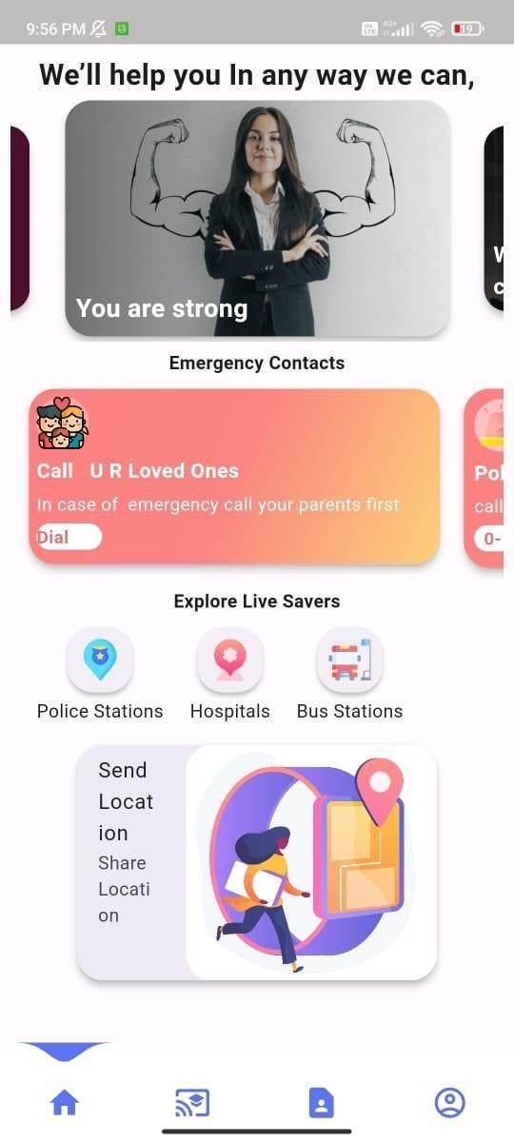
HOME PAGE
SAFETY TIPS PAGE

Slide 24
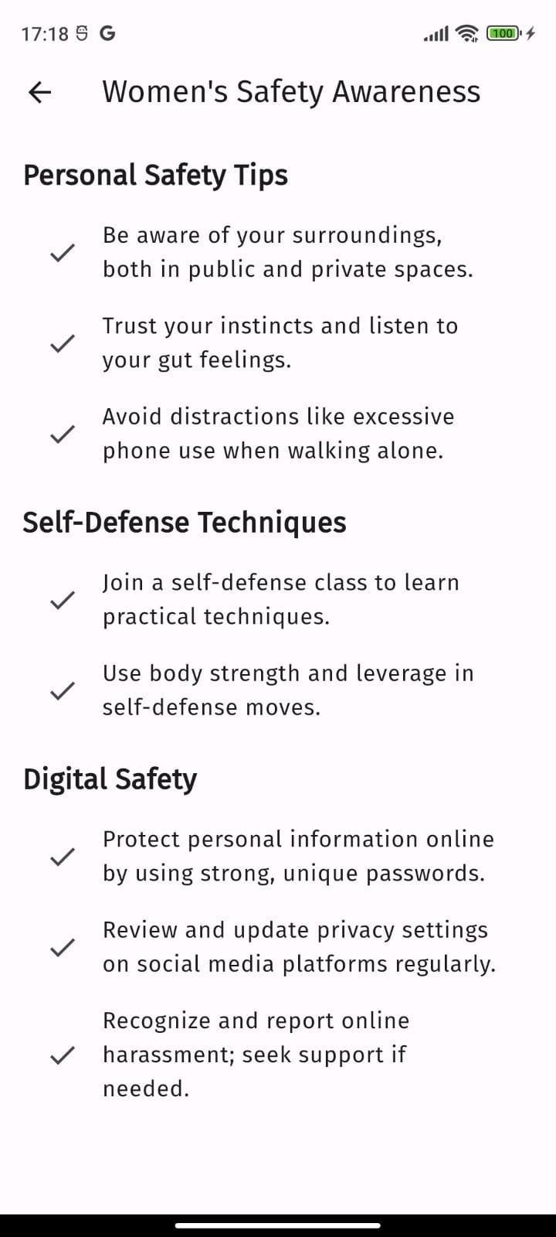
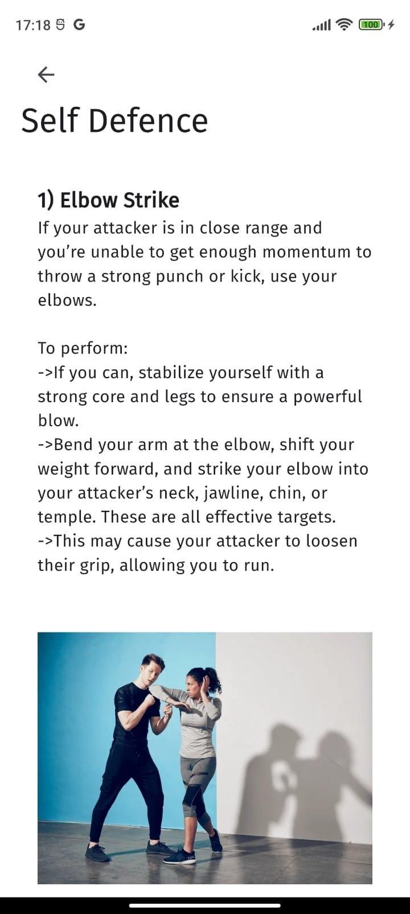
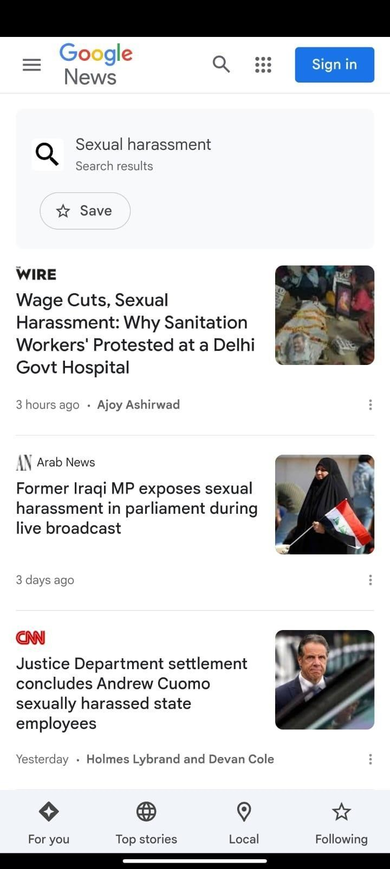

Slide 25
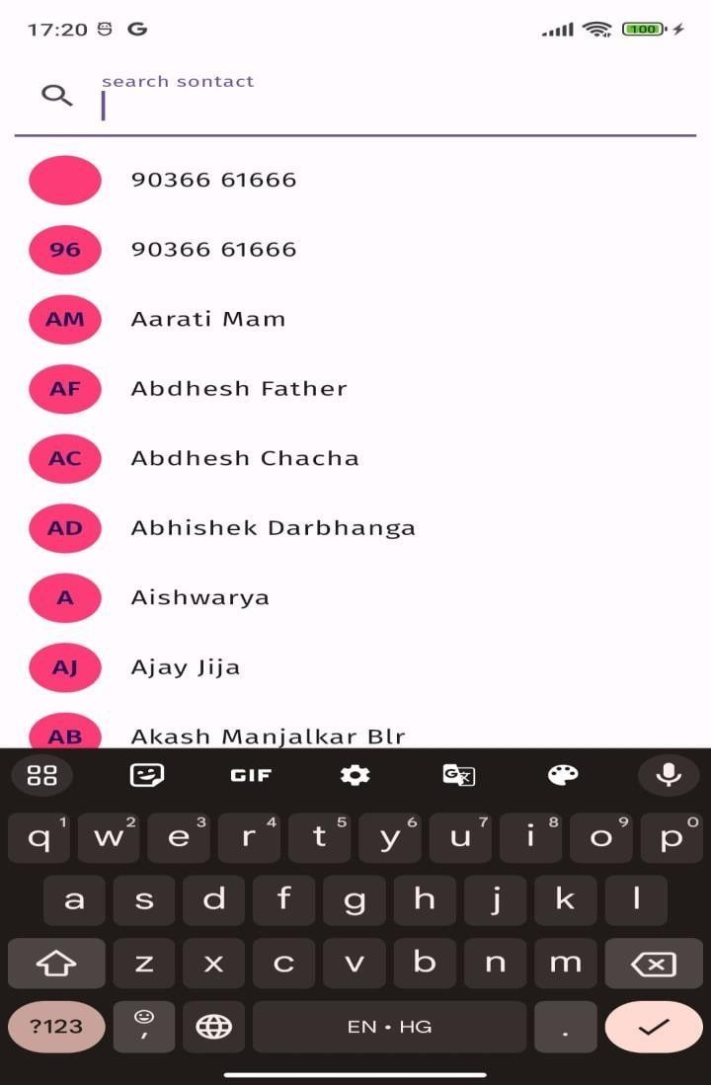

CONTACTS PAGE

Slide 26
Conclusion :
In conclusion, our Women's Safety App is a holistic solution that combines real-time communication, location sharing, and educational components to create a safer environment for women. By incorporating these innovative features, we aim to not only respond to emergencies effectively but also to equip users with the knowledge and tools they need to stay safe in any situation.

Slide 27
Thank You

